Slide 1
Website for Student Enrollment
Name of the Guide :Ms.B.V.N.Praveena
Designation: Assistant Professor
Batch No:A14
Members:
20H71A0565 – Vadlapatla Yamini Krishna Kumari
21H75A0502 – Atluri Pradeepthi
20H71A0551 – Potu Satish
20H71A0517 – Arigela Gopi Kumar

Slide 2
CONTENTS
Introduction
Problem Statement
Existing Systems
Problems in the Existing System
Proposed System
Software Requirements Specifications
UML Diagrams
E-R Diagram
Testing
Output Screenshots
Conclusion

Slide 3
INTRODUCTION
The Student Portal website is an innovative platform designed to empower students in managing their academic journey seamlessly.
The user interface provides a personalized space for students to access and control their academic information efficiently.
Upon logging in, students are welcomed by an intuitive interface displaying their user profile.
Personalized user profiles provided to students with a central hub for managing their academic information.
One of the key feature is the robust course search functionality. Students can easily explore available courses ,view detailed description and check prerequisites empowering them to make informed decisions about their academic path.

Slide 4
PROBLEM STATEMENT
In the past three decades not only has internationalization transformed higher education, it has undergone major changes itself. Education hubs are important new developments. The portal aims to empower students by providing a personalized space for managing academic information efficiently. To address this, there is a need to increase user engagement through awareness campaigns and tutorials, refine the course recommendation algorithm for accuracy, tackle integration challenges with external training platforms, and stay proactive in enhancing data security measures to ensure the confidentiality and integrity of student information. These improvements will contribute to a more effective and user-friendly Student Portal.

Slide 5
EXISTING SYSTEM
Basic Website: The current system likely comprises a basic website where students can access limited information about courses and enrollment procedures.
Manual Registration: Students may need to physically visit administrative offices or fill out paper forms to register for courses, which can be time-consuming and cumbersome.
Limited Course Information: The existing system might lack detailed course descriptions, making it difficult for students to make informed decisions about their academic path.
Lack of Personalization: Without personalized user profiles, students may struggle to manage their academic information efficiently.
Limited Resources: Access to syllabus resources and supplementary materials such as videos may be scarce or unavailable.

Slide 6
PROBLEMS IN EXISTING SYSTEM
The existing system may lack accessibility features, making it difficult for students with disabilities to navigate and utilize the platform effectively.
Registration and course enrollment may rely heavily on manual processes such as filling out paper forms or physically visiting administrative offices. This can be time-consuming and inconvenient for students, especially those who are unable to visit the campus frequently.
Without an efficient online system, students may not have access to real-time updates on course availability, changes in schedules, or other important information, leading to confusion and frustration.
The existing system may not offer robust course search functionality, making it challenging for students to find relevant courses based on their interests, requirements, or prerequisites.

Slide 7
Proposed System
User Profiling: The system begins by creating user profiles based on user interactions, preferences, and historical data. Factors such as viewing history, liked videos, and user demographics are analyzed to understand individual preferences and learning objectives.
Content Analysis: Utilizing advanced algorithms, the system analyzes the content of YouTube videos, including titles, descriptions, and tags.
Recommendation Generation: Based on user profiles and content analysis, the system generates personalized course recommendations for each user. Recommendations are tailored to match the user's interests, skill level, and learning goals, ensuring relevance and engagement.
Feedback Loop: The system incorporates a feedback loop mechanism to refine recommendations over time. User feedback, such as ratings, watch time, and engagement metrics, is collected and used to continuously improve the recommendation algorithms, ensuring that recommendations remain accurate and effective.

Slide 8
Software Requirements Specifications
Hardware Requirements:
Server: A dedicated server with sufficient processing power, memory, and storage capacity to host the application and manage database operations.
Network Infrastructure: Reliable internet connectivity with adequate bandwidth to support concurrent user access and data transfer.
Client Devices: Compatible web browsers and mobile devices with internet connectivity to access the application interface.
Software Requirements:
Development Tools: Integrated Development Environment (IDE) - Examples: Visual Studio Code, PyCharm .
Web Frameworks: Use frameworks such as Django (Python), React (JavaScript) for building the application backend and frontend components.
Security Libraries: Integrate security libraries and frameworks (e.g., Spring Security, OAuth) to enforce authentication and authorization mechanisms.
Testing Tools: Employ testing frameworks (e.g., JUnit, Selenium) for automated unit testing, integration testing, and user acceptance testing.

Slide 9
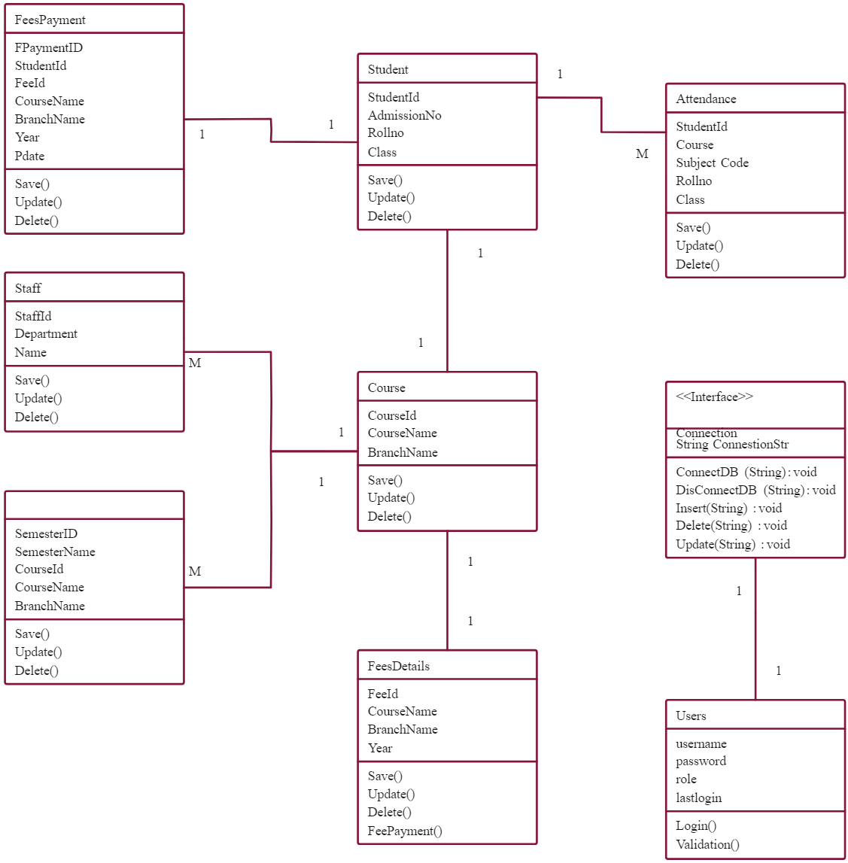
Class Diagram

Slide 10
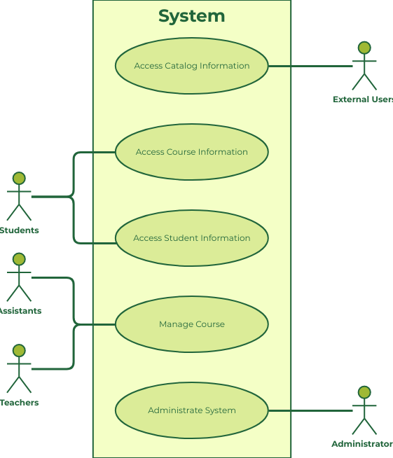
Use Case Diagram

Slide 11
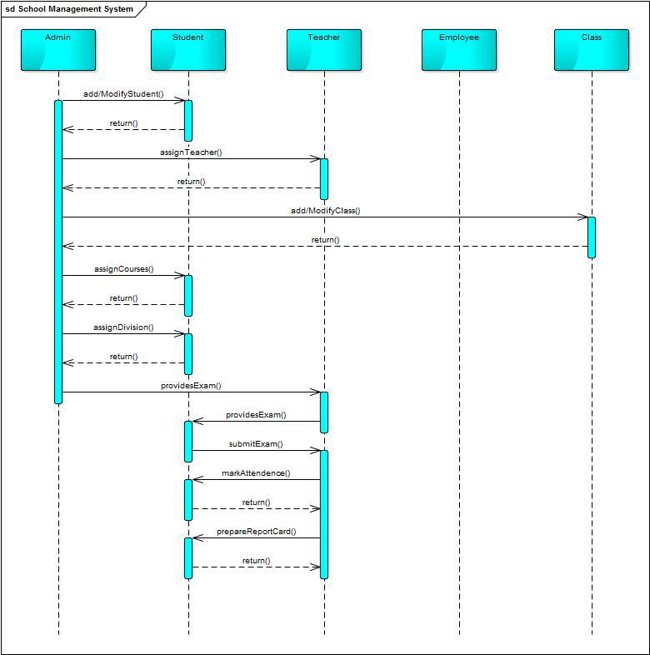
Sequence Diagram

Slide 12
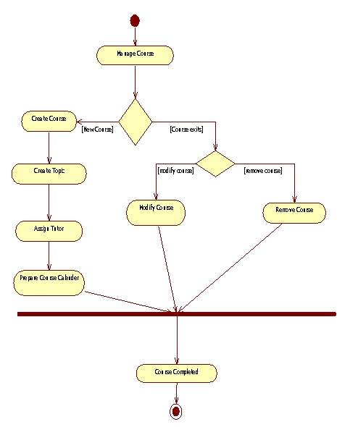
Activity Diagram

Slide 13
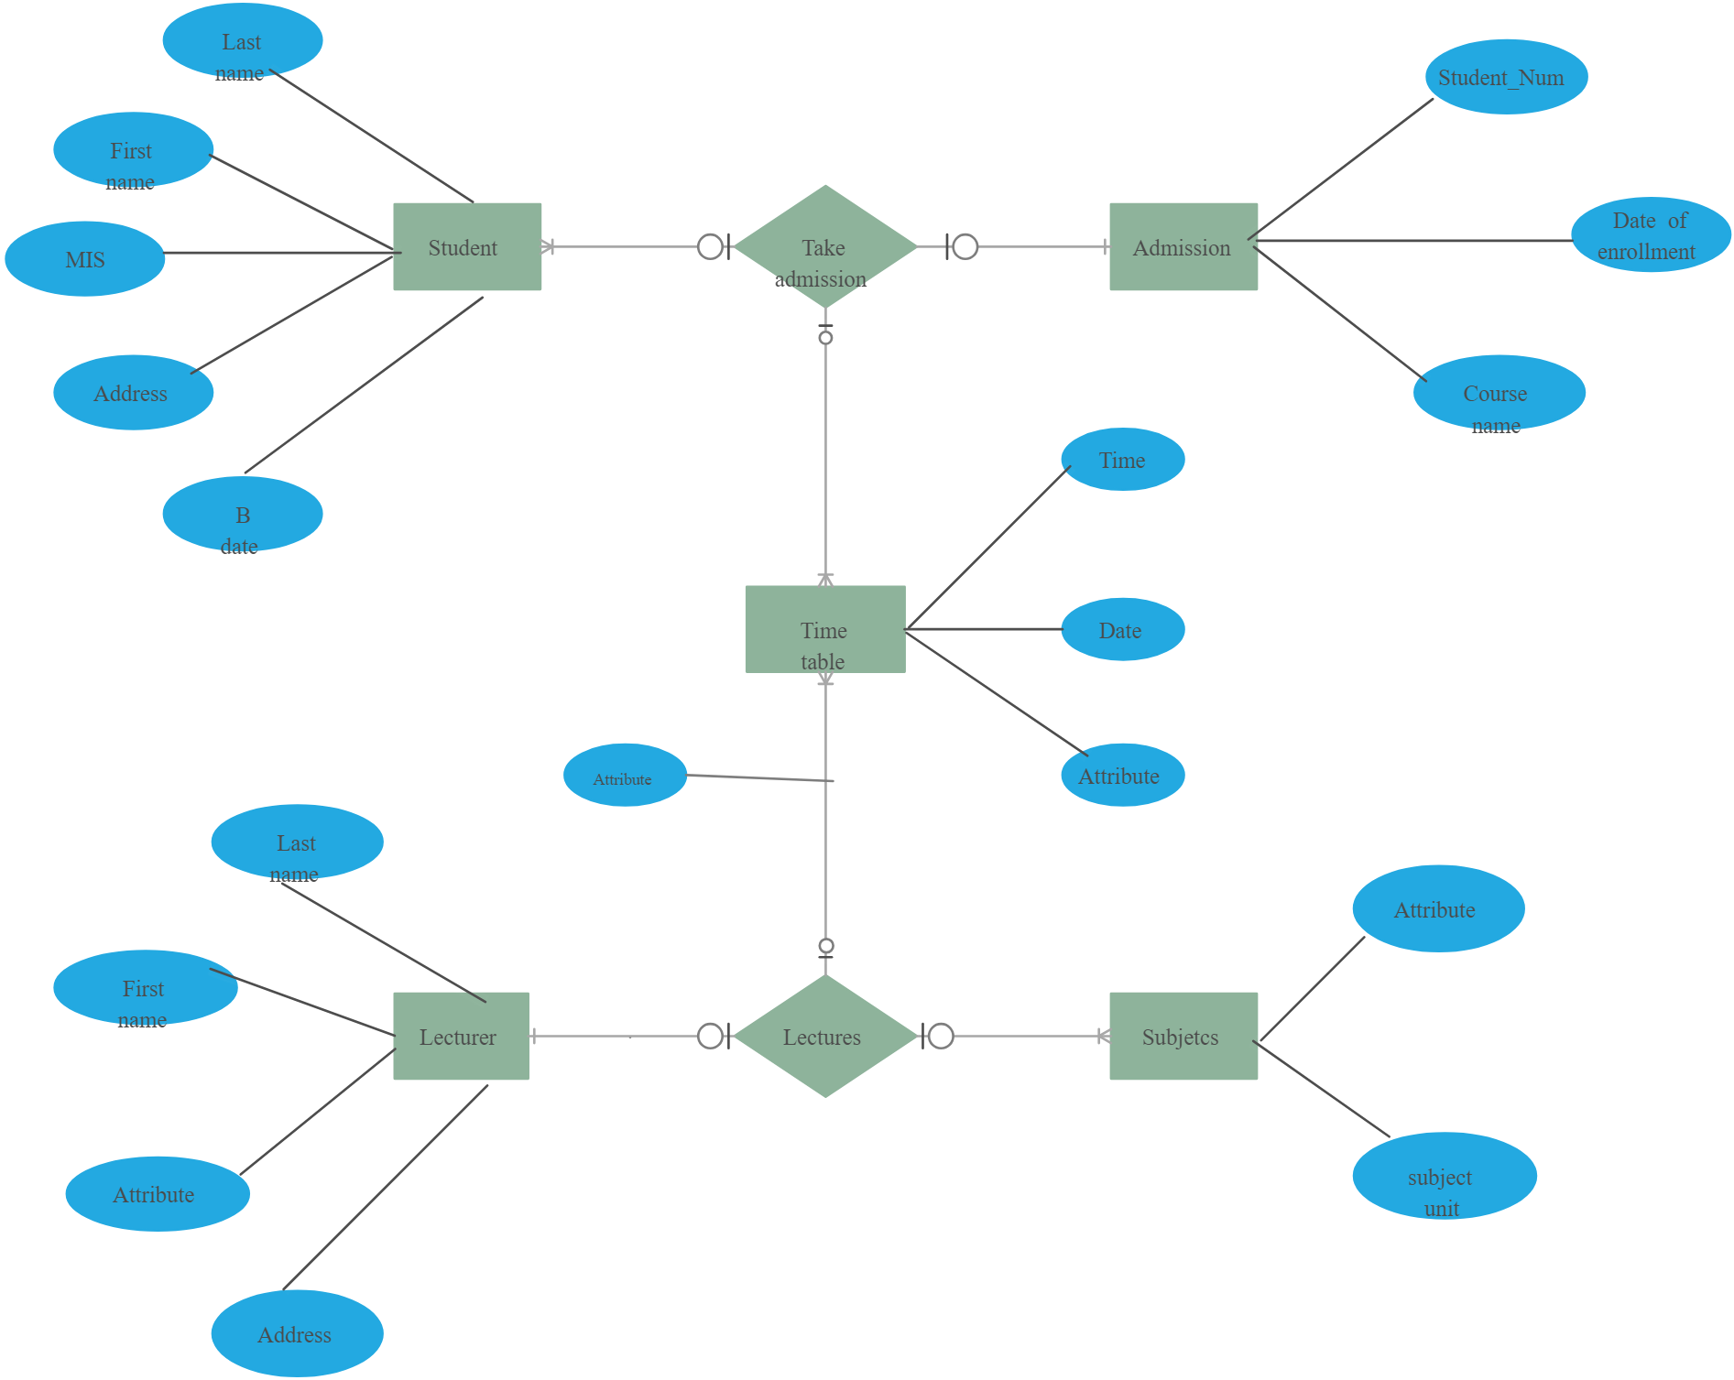
ER Diagram

Slide 14
Testing
Unit testing:
Unit testing involves the design of test cases that validate that the internal program logic is functioning properly, and that program inputs produce valid outputs. It is the testing of individual software units of the application. This is a structural testing, that relies on knowledge of its construction and is invasive. Unit tests perform basic tests at component level and test a specific business process, application, and/or system configuration.
Integration testing
Integration tests are designed to test integrated software components to determine if they actually run as one program. Testing is event driven and is more concerned with the basic outcome of screens or fields.

Slide 15
Testing
System Test
System testing ensures that the entire integrated software system meets requirements. It tests a configuration to ensure known and predictable results. An example of system testing is the configuration oriented system integration test.
Performance testing
Assessing the speed, responsiveness, and scalability of the website, especially under varying levels of traffic and load conditions.
Compatibility testing
Verifying that the website displays and functions correctly across different devices (desktops, tablets, smartphones) and web browsers.
Content testing
Reviewing the accuracy, completeness, and relevance of the content on the website, including text, images, videos, and multimedia elements.

Slide 16
Testing
Functionality testing
Ensuring that all functions and features of the website work as intended, including forms, navigation, links, and interactive elements.
Usability testing
Evaluating the user experience (UX) design of the website to ensure it is intuitive, easy to navigate, and meets the needs of the target audience.
Cross-device testing
Testing the website's compatibility and responsiveness across different devices, including desktops, laptops, tablets, and smartphones, with varying screen sizes and resolutions.

Slide 17
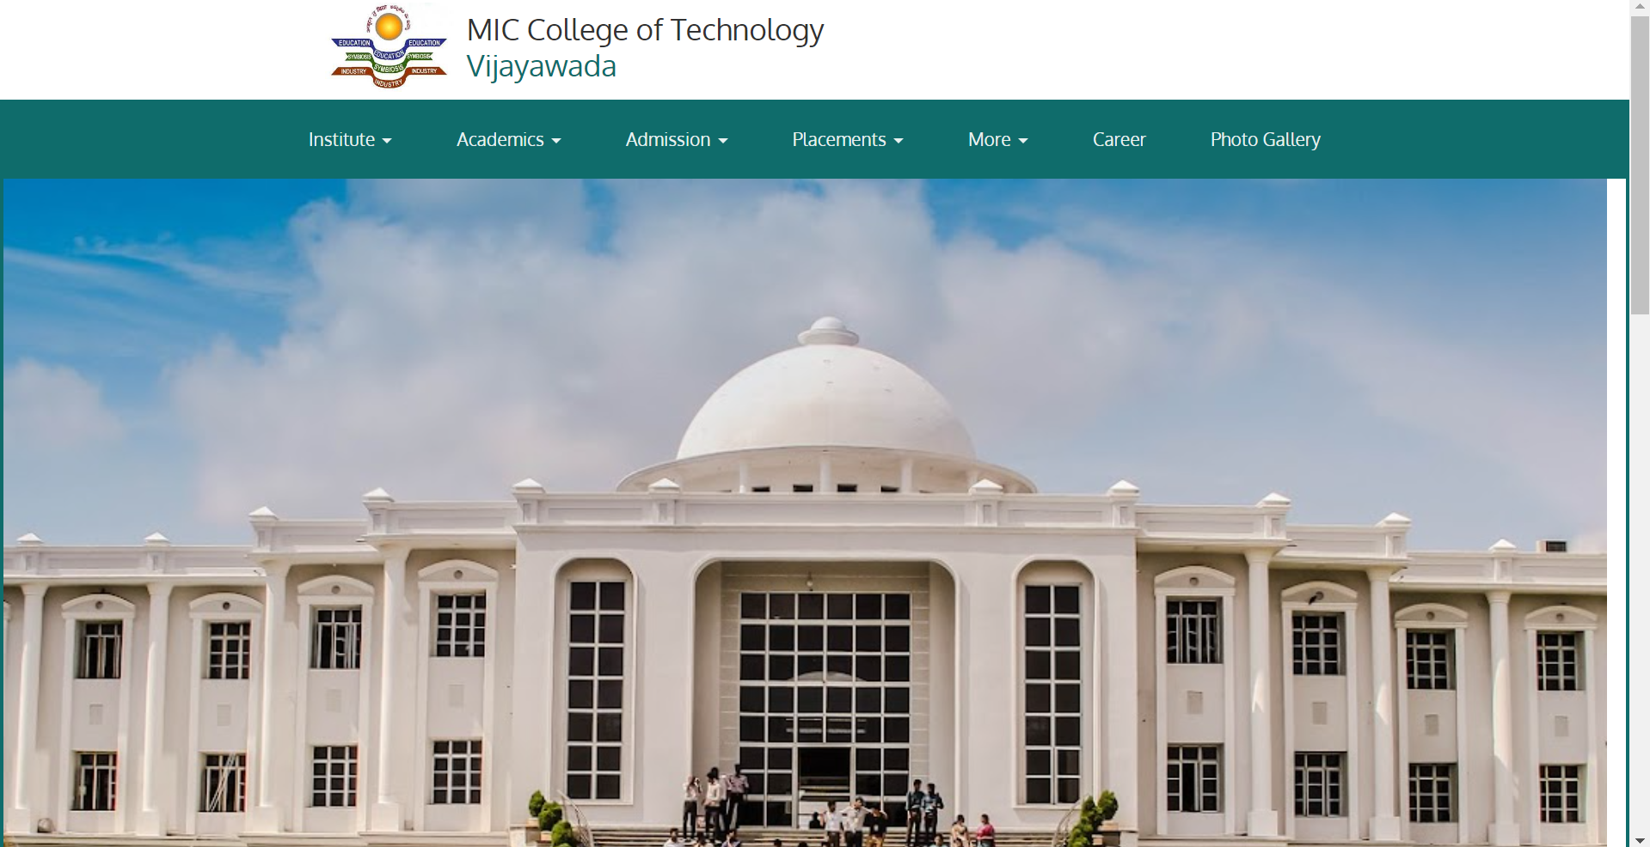
Output Screenshots
Website Creation for College

Slide 18
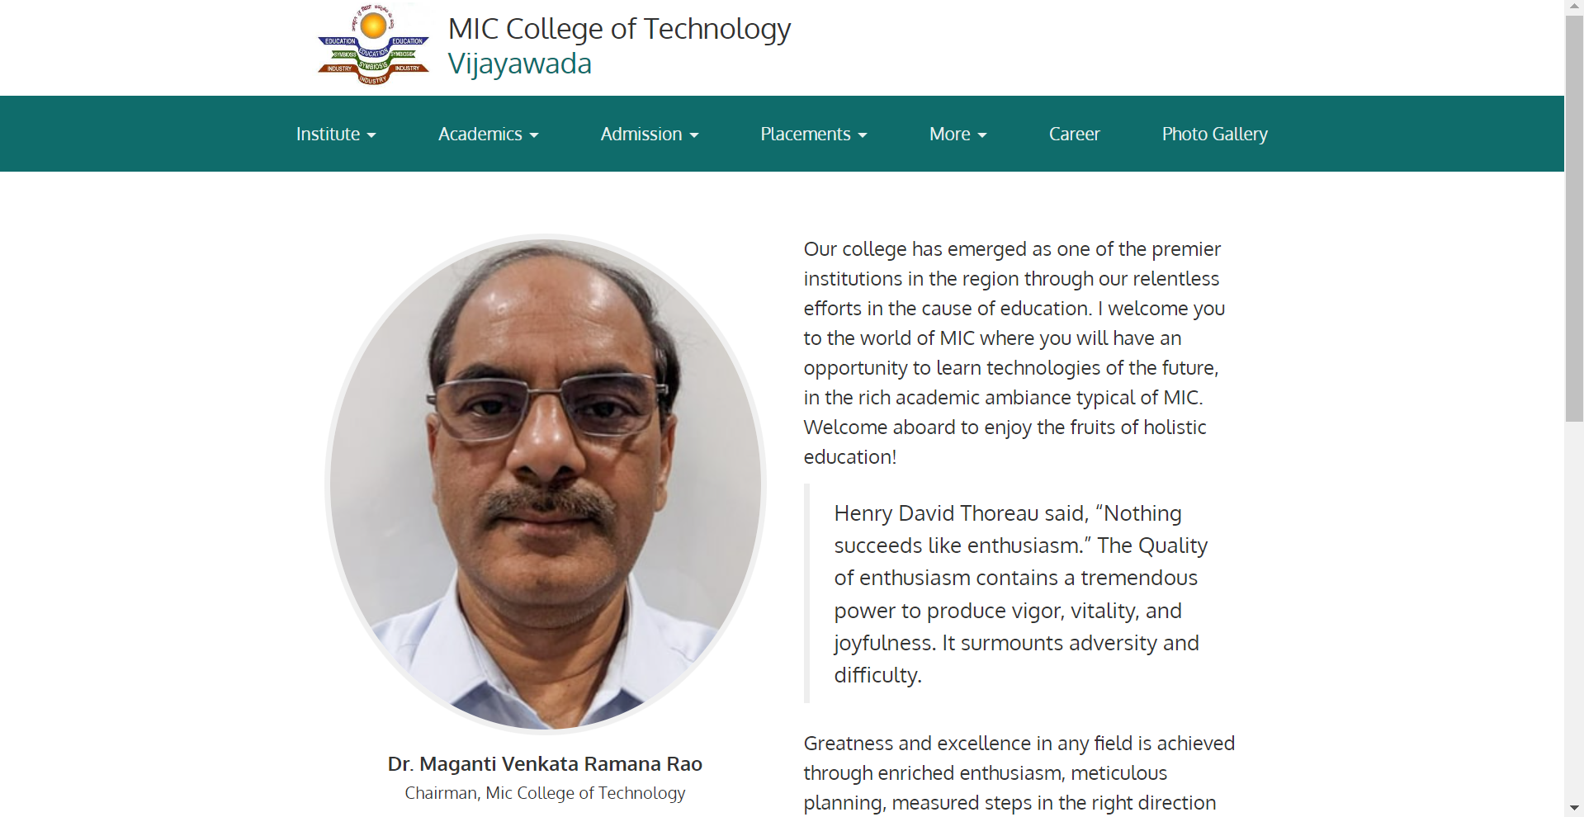
Output Screenshots
Directors Page of Website

Slide 19
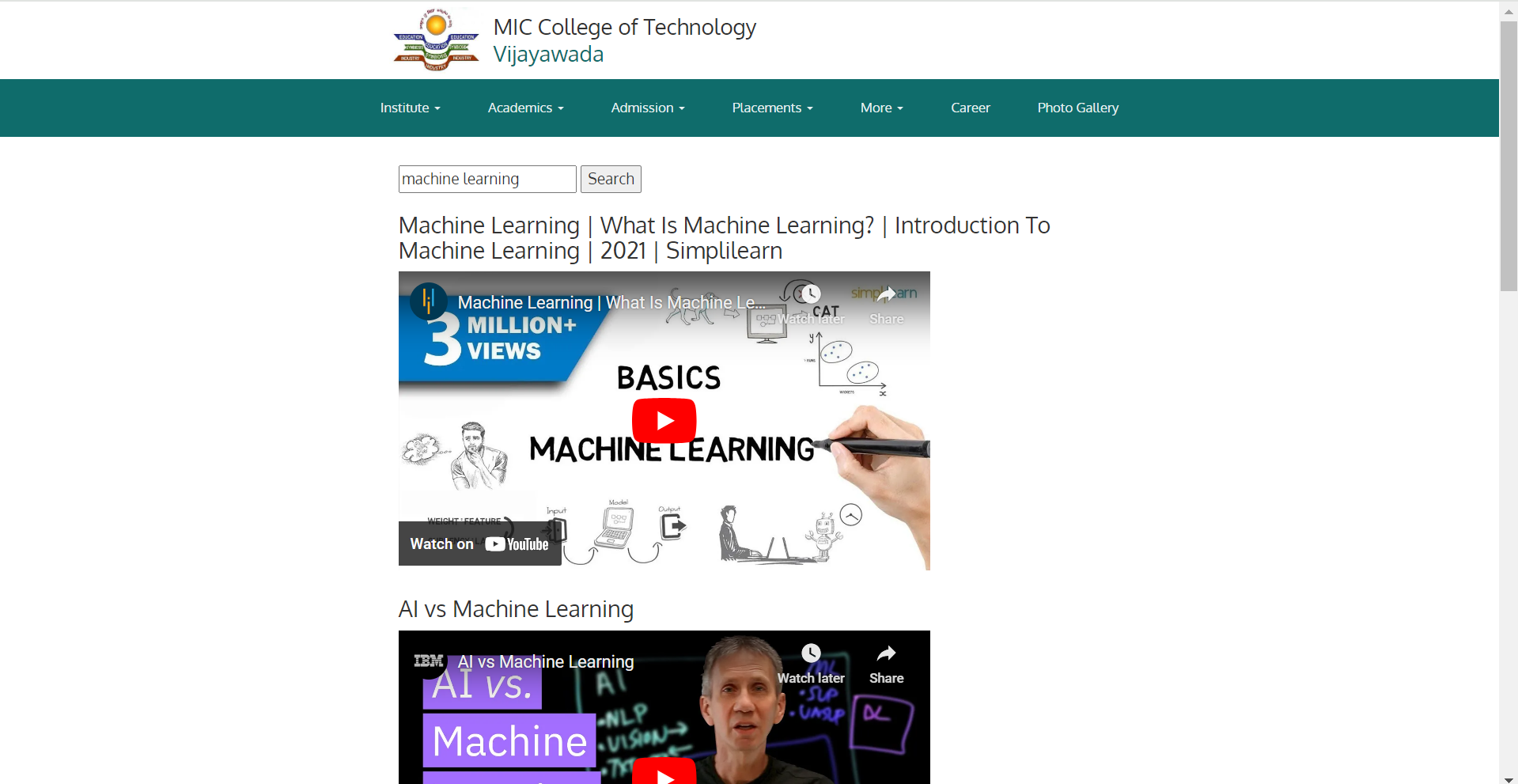
Output Screenshots
Course Recommendations

Slide 20
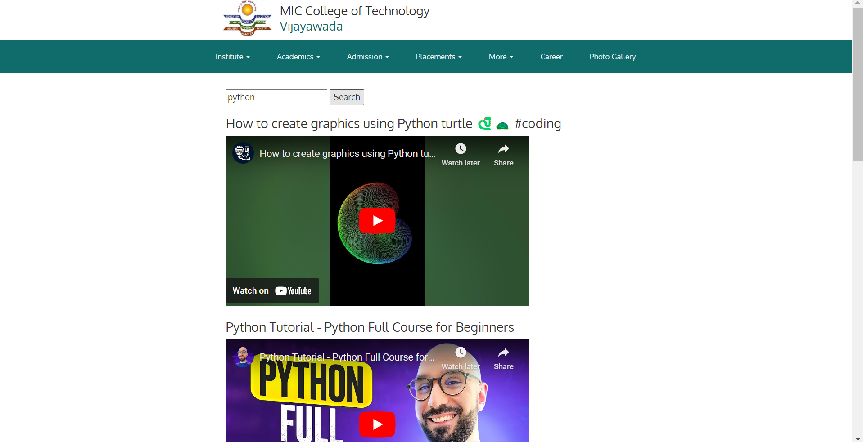
Output Screenshots
Course Recommendations

Slide 21
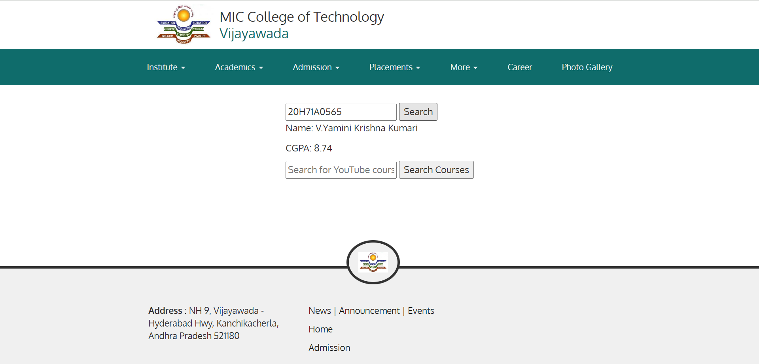
Output Screenshots
GPA Course Recommendation

Slide 22
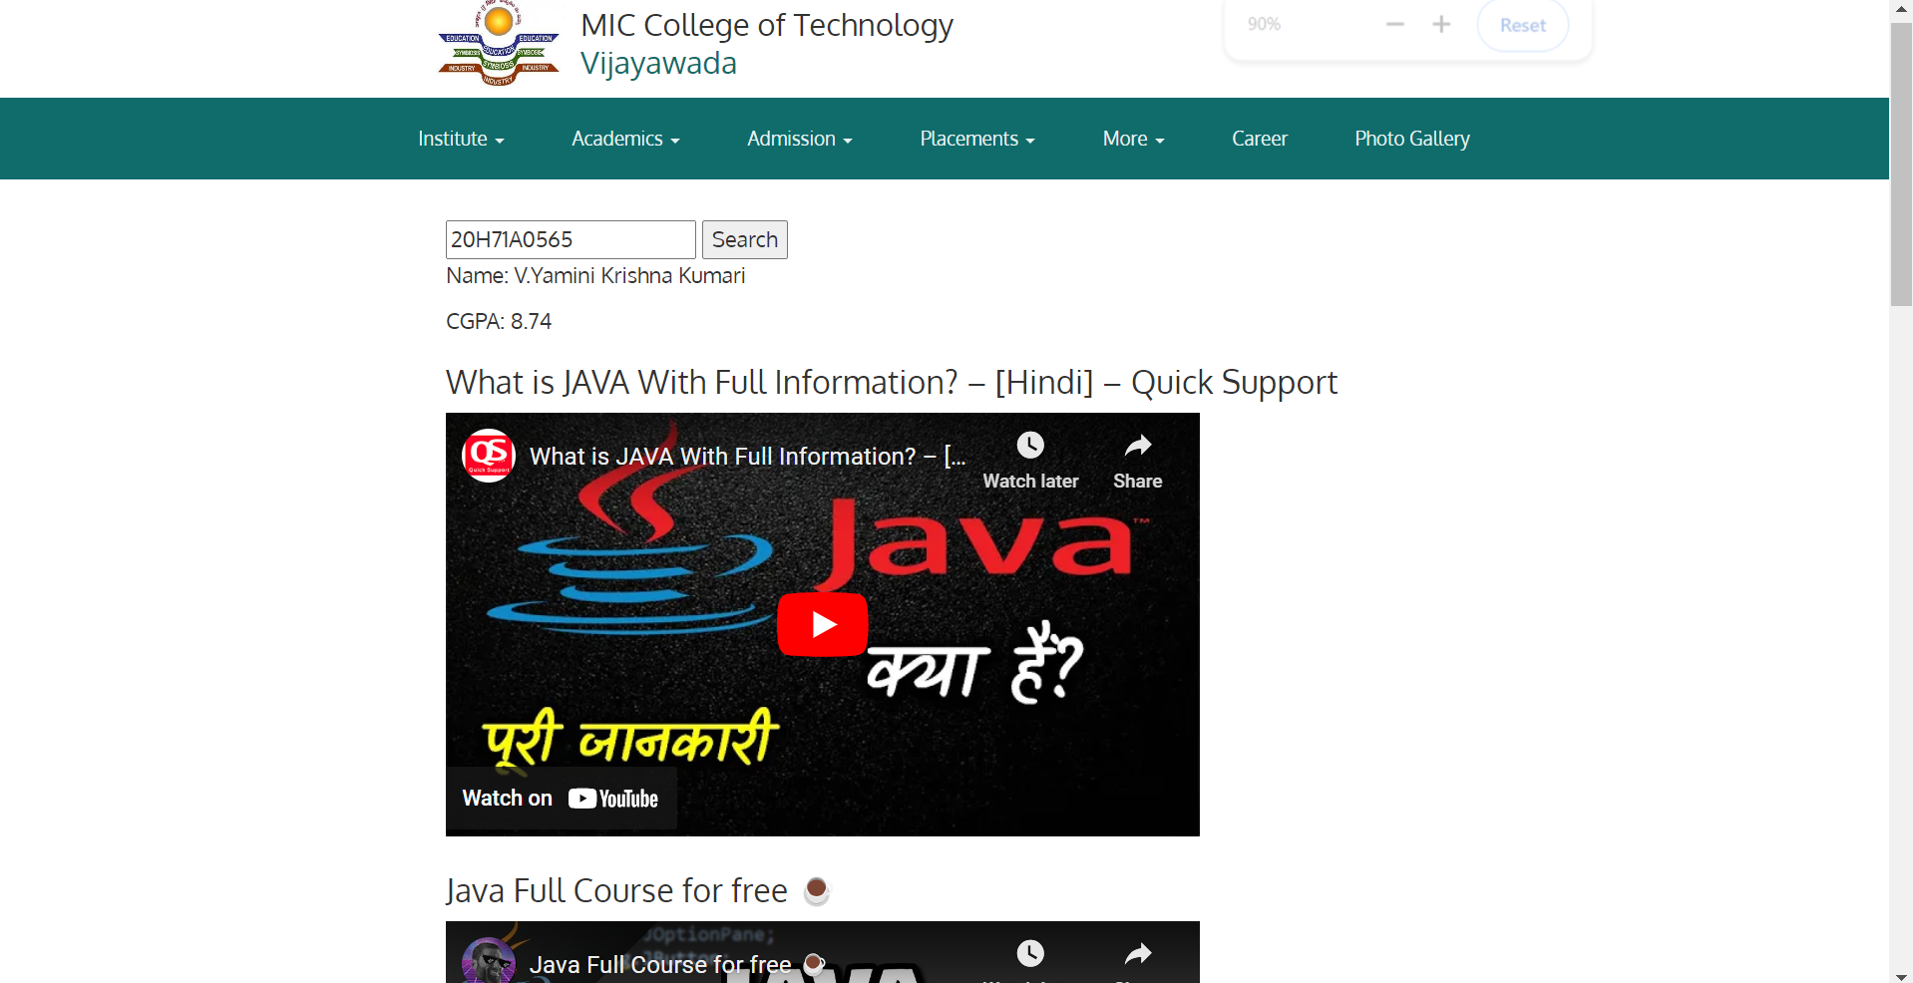
Output Screenshots
GPA Course Recommendation

Slide 23
CONCLUSION
The implementation of a sophisticated recommendation system based on keywords and GPA thresholds represents a pivotal advancement in personalized learning experiences within the college environment.
By leveraging advanced technologies such as collaborative filtering, and adaptive learning algorithms, the system empowers students to explore, discover, and engage with course offerings tailored to their individual interests, abilities, and aspirations.
Through continuous refinement, transparency, and user-driven feedback mechanisms, the recommendation system not only enhances academic success but also fosters a culture of lifelong learning, innovation, and empowerment within the academic community.

Slide 24
References
Patnaik, Srikant, et al. "College management system." International Research Journal of Engineering and Technology (IRJET) 3.5 (2016): 659-661.
Kadam, A. J., et al. "Mobile Web Based Android Application for College Management System." Int. J. Eng. Comput. Sci 6.2 (2017): 20206-20209.
Lavay, Barry, et al. "Behaviour management instructional practices and content of college/university physical education teacher education (PETE) programs." Physical Education & Sport Pedagogy 17.2 (2012): 195-210.
Margolin, Jonathan, Shazia Rafiullah Miller, and James E. Rosenbaum. "The community college website as virtual advisor: A usability study." Community College Review 41.1 (2013): 44-62.
Tian, Weihong. "The construction of teaching system of website construction for college e-commerce major in the era of big data." Journal of Physics: Conference Series. Vol. 1574. No. 1. IOP Publishing, 2020.
Antman, Elliott M., et al. "ACC/AHA guidelines for the management of patients with ST-elevation myocardial infarction: a report of the American College of Cardiology/American Heart Association Task Force on Practice Guidelines (Committee to Revise the 1999 Guidelines for the Management of Patients with Acute Myocardial Infarction)." Journal of the American college of cardiology 44.3 (2004): E1-E211.

Slide 25


